Slide 1
OTT PLATFORM ANALYSIS
Team Members:
Isha Jain (N241)
Ananya Jajala (N245)
Shantanu Khandelwal (N251)
Project Mentor:
Prof. Shubham Joshi

Slide 2
Over-The-Top Platforms
Abstract:
COVID-19 is a global pandemic unlike any other, and it has transformed the way people consume media. Many studies show that the market for on-demand content on OTT platforms is rising, as is customer demand for it. OTTs provide consumers with a never-before-seen advantage: a wide range of content, ease of access, and device/medium options . The researchers looked at the evolution of the OTT space in India and around the world for this study. An examination of the rise in OTT uptake is also included - Pre and post COVID 19 in India, as well as the elements influencing audience preference and ratings, according to IMdB. To track the material release around the world, a k-means clustering technique is used.
Keywords:
COVID 19, OTT platform, Consumer, Netflix, Amazon Prime, Entertainment.

Slide 3
Domain
The need of an easy and “Use it anytime, anywhere” technology is increasing day by day. With a digital era approaching, the entertainment industry is taking a turn and getting digitized as well. Thus creators are looking to make their platforms more User-friendly and accessible. With Multiple Compatibility, Understanding the Customer’s Journey, Cost-Effectiveness, Measurability and High-Quality content, the traditional Theatre methods are diminishing and people are shifting towards OTT platforms.
Our paper talks about trends of OTT across various factors and its shifts during pandemic, where everything became digitized. This paper helps creators improve their content and make it more accessible to even interior parts of our country. With different tastes in platforms, content, genres; the creators have to cover a variety of sections to increase their reach. Our paper suggests the user preferences and likes across different criterias. This will help give the users a more ethnic and personalised experience.

Slide 4
Introduction
The term "OTT" refers to any streaming service that offers content over the internet. OTT is a platform that, unlike traditional cable TV, provides movies and TV series/shows through the internet. These OTT platforms work just like any other app or service on the internet; all you need is a device that supports OTT and an internet connection. From carefully regulated television and film censorship to today's free-to-all internet-enabled OTT entertainment, new generation mediums have empowered consumers to make their own decisions. While OTT has become the new buzzword, people may be surprised to learn that OTTs have been in India for more than a decade. India got its first OTT mobile app, nexGTv, while the medium gained traction when big brands like Zee and Sony entered the market with DittoTV (Zee) and Sony Liv, respectively. In India, there are around 40 OTT providers, including domestic and international businesses like Netflix, Amazon Prime, Disney+ Hotstar, Zee5, and Eros Now. It will not be re-thought how the OTT business will be the substance of the Media and Entertainment Industry in the next few years. The worldwide OTT market has a significant growth potential, according to Allied Market Report research on the OTT Service Market, with a CAGR of 16.7%. (2018-2015). In any case, the rising popularity of online media sources among Indians has transformed the subcontinent into a massive OTT showcase. According to PricewaterhouseCoopers' (PwC) research "Worldwide Entertainment and Media Outlook 2019-2023 (Outlook)," India's OTT sector is anticipated to earn Rs 11,977 crore by 2023. The study looks at Netflix and Hotstar, two of the most popular OTT platforms in India's media and entertainment industry.

Slide 5
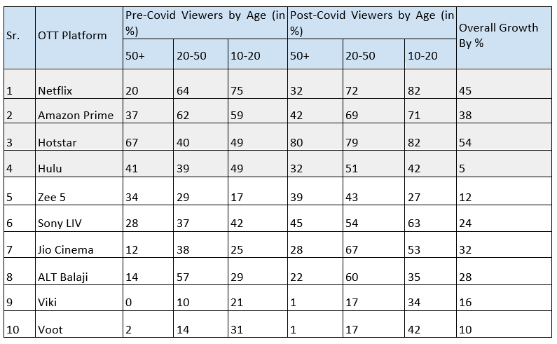
OTT platform’s growth in pandemic in India

Slide 6
Literature Review
Adoption Of OTT Platform In India during COVID-19
In young India, the number of channels available on an average household television has reduced. OTT Platform delves into and explores the creativity of young India during COVID-19, and it is adaptable to a wide range of content on personal devices such as smartphones and tablets, allowing young India to watch whatever they want. OTT subscriber growth surged by 60% during the pandemic, according to a recent Boston Consulting Group research (BCG). In urban regions, COVID-19 performs better as a medium than in semi-urban and rural locations. OTT gained in popularity as individuals were frightened to go out during the outbreak. Most filmmakers are delighted, at least in part, with the favourable interventions they receive from video streaming companies. Another advantage is that one person can take care of the entire family, which saves time and money.
Emergence and future of Over-the-top (OTT) video services in India
With Xiaomi as the most popular Smartphone brand and Jio as the most popular networking service, Hotstar dominates the market of non-paying OTT customers. In addition to streaming, India's online gaming sector is expected to grow to a billion-dollar industry by 2020. Indian teenagers are more interested in gaming on their smartphones than in watching videos. The Indian television sector, which had a revenue of 13,314 million dollars in 2017, is expected to expand at a CAGR of 10.6% to 22,003 million dollars in 2022; at the same time, the global growth rate of television viewing is just 1.4 percent. Over 90% of people in Tamil Nadu, Karnataka, Kerala, and Andhra Pradesh have access to television.

Slide 7
Literature Review
An analysis of customer preference towards OTT Platform
The goal of this research was to see how Indians responded to the new digital powerhouse media. The participants in the research were all aware of OTT platforms and utilised them to replace cable broadcast and DTH. The acceptance of the platforms foreshadowed a greater shift in the near future. Due to its content and Indian flavour, Hotstar enjoys a wider range of connection among Indians. India's digital market will grow at an exponential rate, surpassing the United States as the world's second biggest platform. The media and entertainment industry will have changed dramatically by 2021, with major firms shifting to OTT platforms. You must constantly refresh your content and availability while being cost-effective to reach a bigger audience and stay competitive.
Data Analytics Changing the Pace of Entertainment Industry
People's feelings about watching their favourite shows on television. Fewer people prefer to watch television via satellite or cable. People in the working class have significantly less time to watch television. This trend could be attributed to the emergence of low-cost, high-speed data plans. There are an increasing number of applications that display the same content as television. Because there are so many options out in the open, analytics might be utilised to figure out what content consumers prefer to consume. Advertisements that appear at the beginning or in the middle of online streaming and can be skipped after 5 seconds can be made engaging in the first 5 seconds to entice viewers to watch it rather than skip it. This helps content providers and commercial partners to work together more effectively. The weekday shows should be sharp but rich enough for the viewer to enjoy. This could help with the footprints on weekdays.

Slide 8
Literature Review
An Analytical Study of Use of Data mining for Entertainment
Consumers may want to acquire a particular date-by-date analysis for events such as cricket, award shows, and so on because a live concert is a one-day event. Season-by-Season Popularity Analysis: We can forecast which types of shows will be popular over a given period of time. Reality shows, for example. Month-by-month Analysis of Popularity: We can analyse the popularity of shows by month and establish a watch list. Soap operas, for example. Customers should be able to choose individual channels rather than a group of channels because it has been revealed that one or two channels may have higher or lower TRP than others. It means that each channel can be modified and combined in order to create a new group based on the customer's choices. Although many service providers are always launching new types of shows, customer preferences vary depending on region and season.
Consumption of OTT Media Streaming in COVID-19 Lockdown
There's always room to improve the psychometric and diagnostic properties of the measures, as well as expand the scope of future studies by incorporating other essential variables into the research framework. Providers want to develop a 'fan-base' of customers who are emotionally invested in the firm and its offerings. Providers re-bundle or re-aggregate their content libraries to include more services like video, music, and gaming. Consumers can be offered ad-supported content, or advertising in exchange for "free" (non-subscription) material.

Slide 9
Literature Review
Usage of OTT Platforms during COVID-19 Lockdown: Trends, Rationale And Implications
In India, factors such as the expanding use of smartphones and the affordable availability of internet data are also important. The blockade had a considerable effect on Indian viewers' viewing habits and patterns. Binge Watching is a habit made easier by lockdown settings, and it could signal a future shift in the OTT sector. The majority of respondents were more interested in OTT platforms because of the variety of content available, the availability of global content, and the seemingly endless selection of programmes and web series that can be a good way to pass the time when time is limited, as it is now, especially for those who are required to work from home for no or limited hours. Homemakers have witnessed an increase in OTT usage when it comes to family viewing time as opposed to solo viewing time
A Study on Growth of Over the Top (OTT) Video Services in India
OTT video services, which were formerly considered a luxury, are now considered a need. The number of paid users is increasing as Netflix, Amazon Prime, and Hotstar emerge as the most popular OTT services. The majority of respondents thought that the rise of OTT services had influenced their TV and movie viewing habits. The bulk of users utilise it as a source of nocturnal entertainment on a daily basis. Approximately 81 percent of customers used some type of paid subscription to utilise OTT services, while 19 percent did not. Users' preferred device for watching OTT video is their smartphone.Around OTT services are used on a daily basis by 48% of users, and twice a week by 30% of users. As a result, we might conclude that audiences have grown accustomed to over-the-top entertainment.

Slide 10
Findings
Binge-watching is a habit facilitated by lockdown settings, and it may presage a future shift in the OTT sector.
COVID-19 has played a more significant role in urban regions than in semi-urban and rural regions.
Content of choice and convenience of time are the two main reasons for OTT preference, with gadgets of choice as the third reason.
The number of paying consumers is growing as Netflix, Amazon Prime, Hulu, and Hotstar emerge as the most popular OTT services.
Working from home gave more than 26% of respondents the freedom to use OTT platforms at any time of day.
More than 87 percent of respondents reported an increase in screen usage after COVID, whereas 9.5% reported no significant change.
Users' preferred device for watching OTT video is a smartphone. Smartphones are utilized by around 56% of users. Firestick (25 percent) was in second place, and laptop users were third on the list (11 percent).
In India, Hotstar is the most preferred platform as it has a lot of local content and next is Amazon prime, Netflix with a wide range of genres. Amazon has the highest content (TV Shows + Movies).
Drama and comedy are the most popular genres across all platforms due to their family-friendly content whereas Horror and Animation stand at the bottom of the tier.
Despite OTTs' growing popularity, respondents expressed worries about expensive subscription prices, distractions (information overload), the requirement for high-speed internet, addictive nature, and censorship.

Slide 11
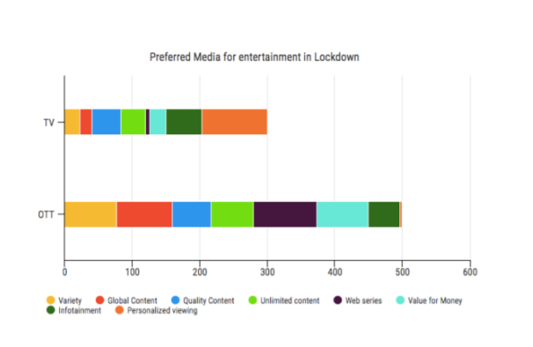
Findings

Slide 12
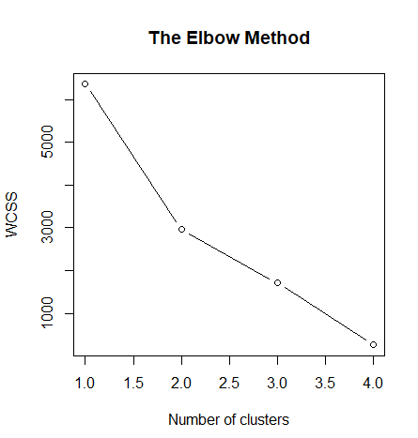
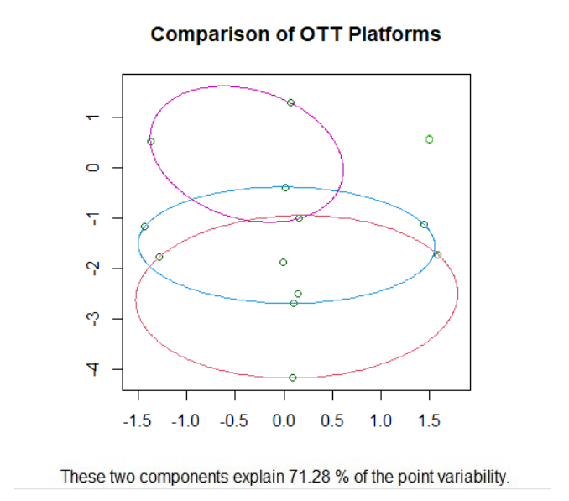
Results

Slide 13
Results / Future Scope
From this we observe that considering the release of movies across different countries, people have voted for Netflix as the most popular platform while Disney has been chosen as the least preferred platform. However, In India, Disney + Hotstar has shown tremendous growth due to its quality Hindi content during the pandemic after the collaboration of Hotstar and Disney as it now includes a wide variety of content for all age groups including the famous cricket league IPL (Indian Premier League).
OTT platforms undoubtedly have a brighter future as people who have begun using this tech will indeed not make u-turn conventional and monotonous entertainment modes. Especially video streaming apps. However, there still lies too much competition in the market. For example, Netflix isn't the only OTT app displaying video streaming; its competitors like Disney, Amazon Prime, & HBO. The things keeping it bright are its high-quality content, video speed & HD, and uninterrupted performance. With yearly revenue of USD 99.69 billion in 2020, this is a stated fact that OTT platforms' potential scope is superb. But to leverage, one must think out of the box in terms of quality & feature integration. The upcoming decade in this arena will most probably belong to not only those with the best original show or film, but also the new-fangled technology, analytics, and user-friendly features. In the long run, the streaming battle will eventually empower the content consumers and revolutionise how they consume content. OTT platforms will continue to challenge the status quo and provide new kinds of entertainment.

Slide 14
Conclusion
Viewing material on any medium is a sort of behaviour that can become habitual over time. Indians have desired a varied choice of information for a long time. A shared household television set with few channels restricted the imagination of young India. OTT players used this creativity during COVID 19, and the ability to access a diverse range of content on personal devices like smartphones and tablets gave young India the flexibility to watch whatever they wanted. OTT providers, on the other hand, have barely scratched the surface of the iceberg; there is a huge opportunity to expand into the regional Indian market in the future. With barely 40 OTT outlets and minimal regional programming, this medium has carved out a unique niche for itself in urban India. COVID 19 has had a significant impact on media uptake in urban areas, where people have more disposable income than in semi-urban or rural India. COVID 19 introduced a number of features that have now become the new normal, such as working from home, which has looked to allow many people more schedule freedom. A spontaneous walk and tea time with a coworker have been replaced by a fast 20-30 minute episode of one's favourite series available on an OTT platform. Every survey reveals that the length of time spent watching video material grows year after year, and COVID 19 has shown to be a turning point in this trend.

Slide 15
References
1. Rachita Ota, Sushree Sangita Ray, Animesh Chandra. “An analysis of customer preference towards OTT Platform”.
2. Sundaravel, E., and N. Elangovan. "Emergence and future of Over-the-top (OTT) video services in India: an analytical research."
3. Dr. S. Anbumalar, Brina Antony, Aiswarya.S, Mithun P.M, Ajeeth kumar.R “ADOPTION OF OTT PLATFORM IN INDIA DURING COVID-19” DOI:16.10089.CEJ.2021.V12I4.285311.3542
4. Pillai, Sini V.. “Data Analytics Changing the Pace of Entertainment Industry Dr .” (2019).
5. Apeksha Ms, Ajmire, Prafulla, 2019/01/13 “Analytical Study of Use of Data mining for Entertainment”
6. Gupta, Garima, and Komal Singharia. "Consumption of OTT Media Streaming in COVID-19 Lockdown: Insights from PLS Analysis." Vision 25.1 (2021): 36-46.
7. Saini, Navsangeet. "USAGE OF OTT PLATFORMS DURING COVID-19 LOCKDOWN: TRENDS, RATIONALE AND IMPLICATIONS." PalArch's Journal of Archaeology of Egypt/Egyptology 17.6 (2020): 4212-4222.
8. Kumari, Tripti. "A study on growth of over the top (OTT) video services in India." International Journal of Latest Research in Humanities and Social Science (IJLRHSS) 3.9 (2020): 68-73

